Slide 1
DEF/LEF to SVG
Ahmed Sharaf-ElDein
Ahmed Marzouk

Slide 2
Problem
- Convert a routed design in DEF and LEF to a layout in SVG

Slide 3
Solution
- Parsing the DEF and LEF files.
- Iterate through the DEF and, using SVG library, draw:
* Every cell given the dimensions stated in the LEF file.
* The pins.
* The nets.

Slide 4
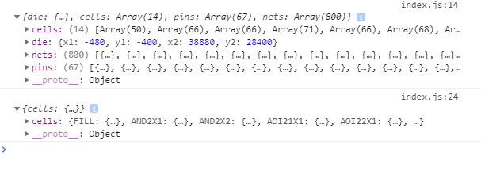
Parsing the DEF and LEF files.

Slide 5
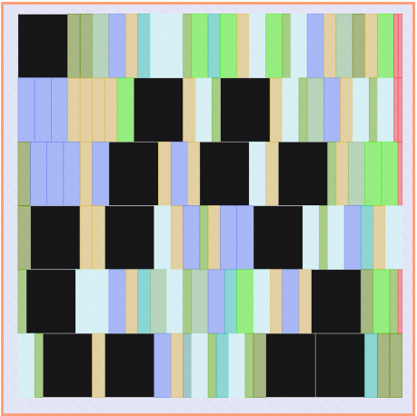
Drawing the cells

Slide 6
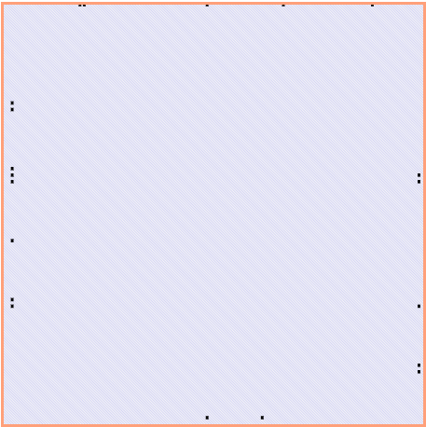
Drawing the pins

Slide 7
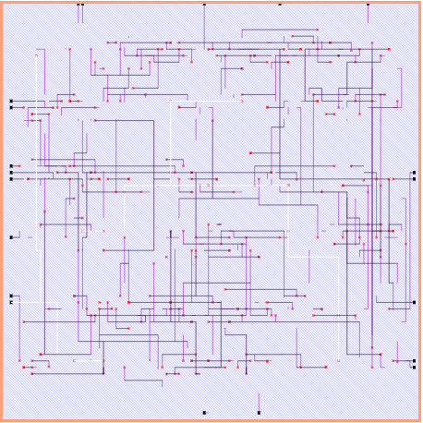
Drawing the Nets

Slide 8
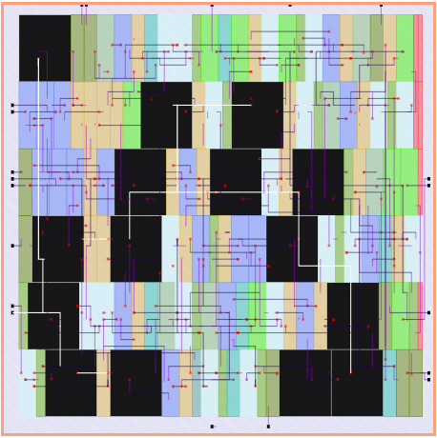
All Together

Slide 9
Libs/tools used
- svgZoomPan https://github.com/ariutta/svg-pan-zoom
- jquery, JavaScript, HTML, CSS
- DEF and LEF parser https://github.com/claude-abounegm/DEF-Viewer/tree/master/DEFViewer/Scripts/Custom

Slide 10
How to build the solution
- just open the index.html file

Slide 11
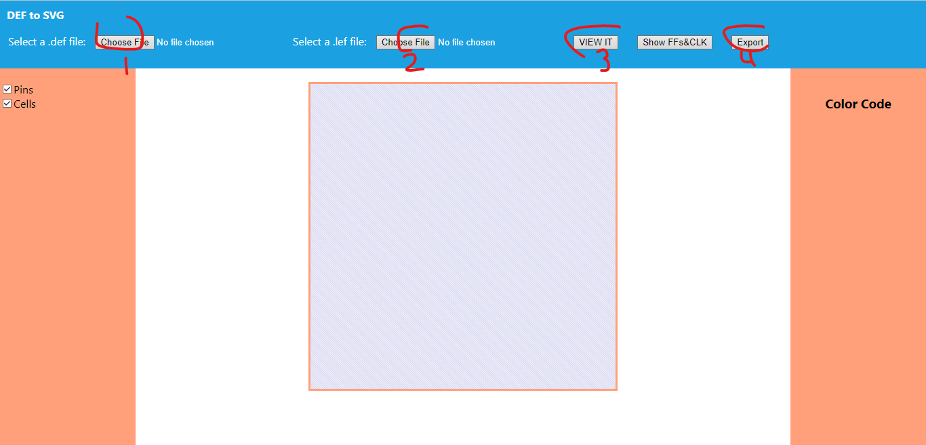
How to run
1- choose DEF file
2- Choose LEF file
3- Press ‘VIEW IT’ to see the SVG layout
4- Export to download the .svg

Slide 12
DEMO

Slide 13
THANK YOU

